Slide 1
Edge AI in IoT
Rajan Samar -IMT2023616
TANMAY kUMAR -IMT2023593

Slide 2
Edge AI
Edge AI is the integration of artificial intelligence (AI) with edge computing, enabling data processing and decision-making to happen on devices close to the source of data rather than relying on centralized cloud servers.
This paradigm shift allows AI-powered devices to function efficiently in real time, without the need for continuous connectivity to cloud-based infrastructure

Slide 3
Edge Computing
Edge Computing enables data to be analysed, processed, and transferred at the edge of a network.
Meaning, the data is analysed locally, closer to where it is stored, in real-time without latency.
Edge computing allows data from Internet of things device to be analysed at the edge of the network before being sent to a data centre or cloud.

Slide 4
Advantages of Edge Computing
Speed: It offers high speed, reduced latency better reliability which allows for quicker data processing and content delivery.
Reliability – Works even if internet/cloud connection fails.
Scalable: It offers a far less expensive route to scalability and versatility, allowing companies to expand their computing capacity through a combination of IoT devices and edge data centres.
Resource effective: Since the data is processed locally, less time and resources are needed for data to be transmitted among the millions of connected devices.
Data Privacy: It guarantees data privacy and security while sending the data over networks across international borders because a sizable amount of raw data is processed close to the protected edge devices.
Effective in constrained bandwidth: In cases of intermittent connectivity and constrained bandwidth brought on by remote places, such as forests or sailing vessels, edge computing is beneficial.

Slide 5
Applications of Edge AI
.
Smart Grids – Predict demand, balance load, reduce outages.
Renewable Energy – Forecast solar/wind output locally, optimize storage
Autonomous Vehicles: Real-time processing of data from cameras and sensors to navigate roads, detect obstacles, and make driving decisions.
Healthcare Monitoring: Wearable devices use Edge AI to monitor vital signs and detect anomalies, providing real-time alerts for medical emergencies.
Smart Homes: Devices like smart speakers, thermostats, and cameras use Edge AI for personalized user experiences and enhanced security.
Industrial Automation: Edge AI in manufacturing monitors machinery, predicts maintenance needs, and optimizes operations, minimizing downtime.

Slide 6
Disadvantages
It requires more storage capacity.
Security challenges in edge computing is high due to huge amount of data.
It only analyze the data.
Cost of edge computing is very high.
It requires advanced infrastructure.

Slide 7
What is Energy Management?
Energy management is the systematic monitoring, controlling, and optimizing of energy production and consumption to ensure efficient usage, cost savings, and sustainability.
Impact :
Reduce energy costs.
Improve efficiency.
Reduce environmental impact.

Slide 8
IoT in Energy Management
Energy management systems leverage connected devices and sensors to gather real-time data, enabling intelligent decision-making.
Intelligent Edge AI → Running AI models directly at the network edge (on devices, gateways, or local servers) instead of only in the cloud.
This reduces latency, saves bandwidth, and allows real-time decision-making.

Slide 9
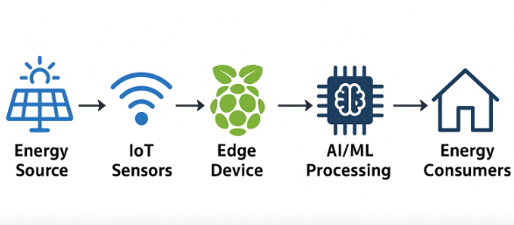
Energy Management using Intelligent Edge AI
Collecting energy-related data (sensors, meters, IoT devices)
Processing it at the edge with AI/ML models
Making fast, autonomous decisions to optimize efficiency, cost, and sustainability.

Slide 10
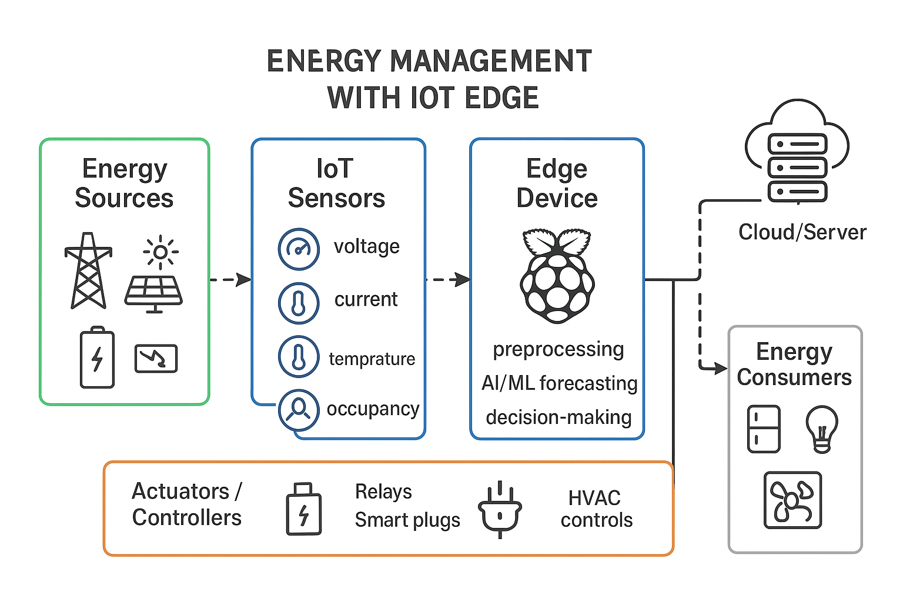

Slide 11
Why to Use Edge AI in Energy Sector?
Energy management requires real-time decisions (load shifting, switching devices off/on at peak times).
Reduces cloud dependency — ideal for places with unstable internet.
Ensures privacy of energy usage patterns.
Cuts down operating costs by avoiding constant high-bandwidth streaming.

Slide 12
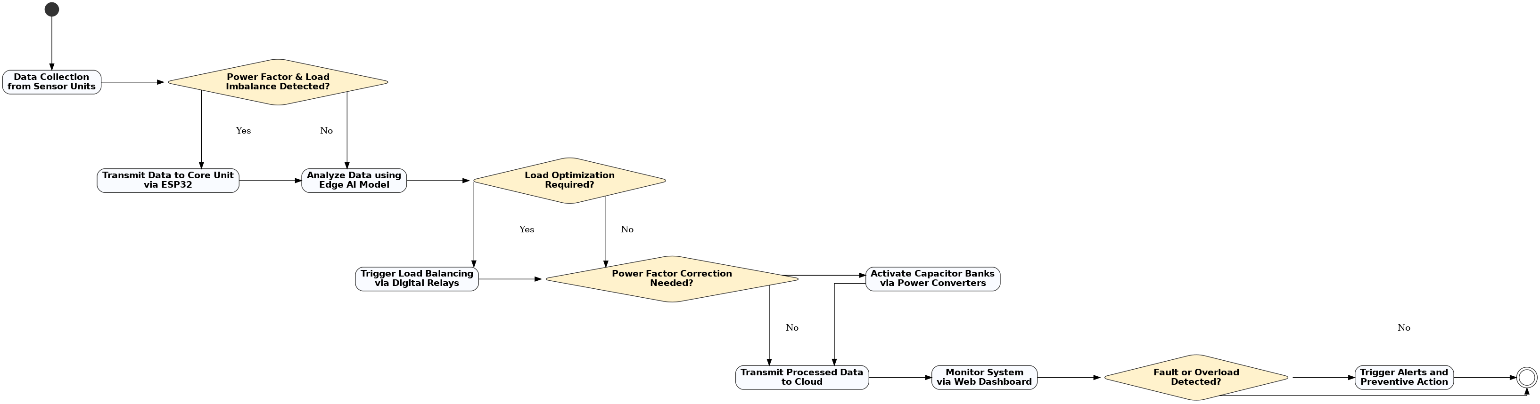
AI-Driven Energy Management System (ADEMS)

Slide 13
IDS (Intrusion Detection System)
Intrusion is when an attacker gets unauthorized access to a device, network, or system. Cyber criminals use advanced techniques to sneak into organizations without being detected.
Intrusion Detection System (IDS) observes network traffic for malicious transactions and sends immediate alerts when it is observed.
It is software that checks a network or system for malicious activities or policy violations.
Each illegal activity or violation is often recorded either centrally using an SIEM system or notified to an administration.
IDS monitors a network or system for malicious activity and protects a computer network from unauthorized access from users, including perhaps insiders.

Slide 14
Working of IDS
An IDS (Intrusion Detection System) monitors the traffic on a computer network to detect any suspicious activity.
It analyzes the data flowing through the network to look for patterns and signs of abnormal behavior.
The IDS compares the network activity to a set of predefined rules and patterns to identify any activity that might indicate an attack or intrusion.
If the IDS detects something that matches one of these rules or patterns, it sends an alert to the system administrator.
The system administrator can then investigate the alert and take action to prevent any damage or further intrusion.

Slide 15
Classification of IDS
Intrusion Detection System are classified into 5 types:
Network Intrusion Detection System (NIDS): Network intrusion detection systems (NIDS) are set up at a planned point within the network to examine traffic from all devices on the network. It performs an observation of passing traffic on the entire subnet and matches the traffic that is passed on the subnets to the collection of known attacks. Once an attack is identified or abnormal behavior is observed, the alert can be sent to the administrator.
Host Intrusion Detection System (HIDS): Host intrusion detection systems (HIDS) run on independent hosts or devices on the network. A HIDS monitors the incoming and outgoing packets from the device only and will alert the administrator if suspicious or malicious activity is detected. It takes a snapshot of existing system files and compares it with the previous snapshot. If the analytical system files were edited or deleted, an alert is sent to the administrator to investigate.

Slide 16
Hybrid Intrusion Detection System: Hybrid intrusion detection system is made by the combination of two or more approaches to the intrusion detection system. In the hybrid intrusion detection system, the host agent or system data is combined with network information to develop a complete view of the network system. The hybrid intrusion detection system is more effective in comparison to the other intrusion detection system.

Slide 17
Application Protocol-Based Intrusion Detection System (APIDS): An application Protocol-based IDS (APIDS) is a system or agent that generally resides within a group of servers. It identifies the intrusions by monitoring and interpreting the communication on application-specific protocols. For example, this would monitor the SQL protocol explicitly to the middleware as it transacts with the database in the web server.
Protocol-Based Intrusion Detection System (PIDS): It comprises a system or agent that would consistently reside at the front end of a server, controlling and interpreting the protocol between a user/device and the server. It is trying to secure the web server by regularly monitoring the HTTPS protocol stream and accepting the related HTTP protocol. As HTTPS is unencrypted and before instantly entering its web presentation layer then this system would need to reside in this interface, between to use the HTTPS.

Slide 18
Signature-Based Detection: Signature-based detection checks network packets for known patterns linked to specific threats. A signature-based IDS compares packets to a database of attack signatures and raises an alert if a match is found. Regular updates are needed to detect new threats, but unknown attacks without signatures can bypass this system

Slide 19
Detection method of IDS
Signature-Based Method: Signature-based IDS detects the attacks on the basis of the specific patterns such as the number of bytes or a number of 1s or the number of 0s in the network traffic. It also detects on the basis of the already known malicious instruction sequence that is used by the malware. The detected patterns in the IDS are known as signatures. Signature-based IDS can easily detect the attacks whose pattern (signature) already exists in the system but it is quite difficult to detect new malware attacks as their pattern (signature) is not known.
Anomaly-Based Method: Anomaly-based IDS was introduced to detect unknown malware attacks as new malware is developed rapidly. In anomaly-based IDS there is the use of machine learning to create a trustful activity model and anything coming is compared with that model and it is declared suspicious if it is not found in the model. The machine learning-based method has a better-generalized property in comparison to signature-based IDS as these models can be trained according to the applications and hardware configurations.

Slide 20
Placement of IDS
The most optimal and common position for an IDS to be placed is behind the firewall. The 'behind-the-firewall' placement allows the IDS with high visibility of incoming network traffic and will not receive traffic between users and network.
In cases, where the IDS is positioned beyond a network's firewall, it would be to defend against noise from internet or defend against attacks such as port scans and network mapper. An IDS in this position would monitor layers 4 through 7 of the OSI model and would use Signature-based detection method. Showing the number of attempted breaches instead of actual breaches that made it through the firewall is better as it reduces the amount of false positives. It also takes less time to discover successful attacks against network.

Slide 21
An advanced IDS incorporated with a firewall can be used to intercept complex attacks entering the network. Features of advanced IDS include multiple security contexts in the routing level and bridging mode. All of this in turn potentially reduces cost and operational complexity.
Another choice for IDS placement is within the network. This choice reveals attacks or suspicious activity within the network. Not acknowledging security inside a network is detrimental as it may allow users to bring about security risk, or allow an attacker who has broken into the system to roam around freely.

Slide 22
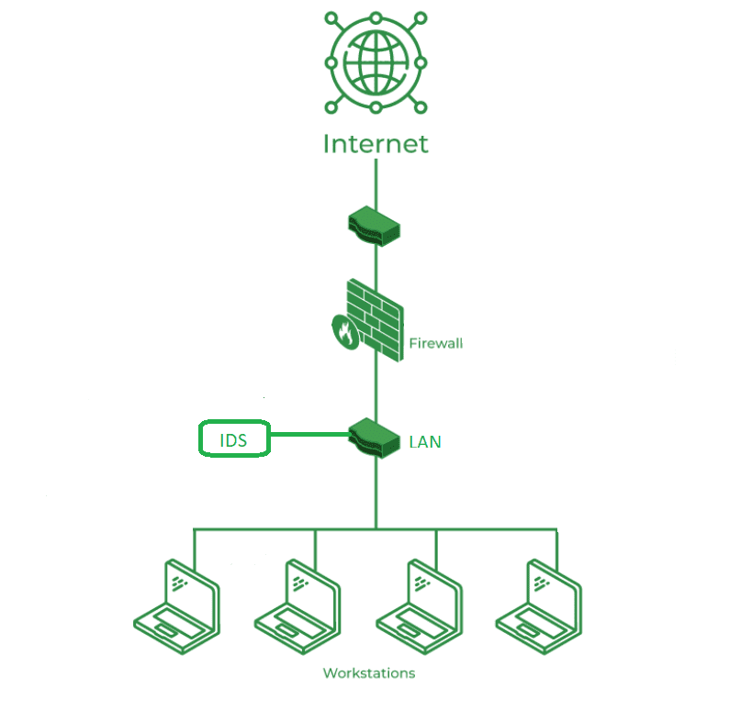

Slide 23
Benefits of IDS
Detects Malicious Activity: IDS can detect any suspicious activities and alert the system administrator before any significant damage is done.
Improves Network Performance: IDS can identify any performance issues on the network, which can be addressed to improve network performance.
Compliance Requirements: IDS can help in meeting compliance requirements by monitoring network activity and generating reports.
Provides Insights: IDS generates valuable insights into network traffic, which can be used to identify any weaknesses and improve network security.

Slide 24
Drawbacks of IDS
False Alarms: IDS can generate false positives, alerting on harmless activities and causing unnecessary concern.
Resource Intensive: It can use a lot of system resources, potentially slowing down network performance.
Requires Maintenance: Regular updates and tuning are needed to keep the IDS effective, which can be time-consuming.
Doesn't Prevent Attacks: IDS detects and alerts but doesn’t stop attacks, so additional measures are still needed.

Slide 25
AMI (Advanced Metering Infrastructure)
Advanced metering infrastructure (AMI) is an integrated, fixed-network system that enables two-way communication between utilities and customers. The system collects, stores, analyzes and presents energy usage data, providing utility companies the ability to monitor electricity, gas and water usage in real time.
Water utilities, for example, rely on AMI meters to provide comprehensive flow data. If the data points to excessive water use patterns, which might indicate a leak, the company can notify the customer or make the necessary repairs.

Slide 26
Need of IDS for AMI
AMI systems reliance on the internet, a public network, exposes them to vulnerabilities and cybersecurity threats.
The inherent resource constraints of smart meter devices, such as limited memory and computing power, complicate the implementation of traditional security solutions, heightening concerns about cybersecurity risks.
To address this challenge, we utilize machine learning techniques to develop a lightweight Intrusion Detection System (IDS) to protect AMI systems.

Slide 27
IDS Anomaly Detection in AMI
An Intrusion Detection System (IDS) with anomaly detection can help secure AMI by:
Baseline Learning: It learns the normal behavior of smart meters, traffic patterns, and power usage.
Detecting Abnormalities: If traffic, consumption data, or communication deviates significantly from the learned model, IDS flags it as suspicious.

Slide 28
Benefits of Edge-based IDS in Smart Metering:
Real-time detection → Immediate reaction to abnormal traffic or meter behavior.
Distributed defense → Each meter or local concentrator can stop compromised nodes before damage spreads.
Reduced latency → No need to send everything to the cloud/utility HQ.
Scalability → Security checks are spread across millions of meters.
Mitigation actions at edge:
Isolating a compromised meter.
Dropping suspicious packets.
Limiting abnormal load reporting.
Notifying utility control center

Slide 29
Example Scenario
A hacker tries false data injection: modifies meter readings to show very low consumption.
Without IDS → Data is accepted → Revenue loss, faulty demand response.
With Anomaly-based IDS at Edge → Detects unusual pattern (e.g., sudden drop inconsistent with history or neighborhood trends) → Flags and blocks it → Alerts utility.

Slide 30
Energy Management
Rajan samar

Slide 31
Purpose:
The purpose of this study is to evaluate multiple machine-learning models for three key IIoT smart-grid tasks: power consumption prediction, energy-efficiency estimation, and user-type classification.
Beyond accuracy, the analysis includes training time, inference latency, memory footprint, and minimum required datapoints — factors that are essential for real-time IoT deployment.
By comparing several classical and tree-based models, the study identifies the most efficient and deployable models for practical smart-grid edge applications

Slide 32
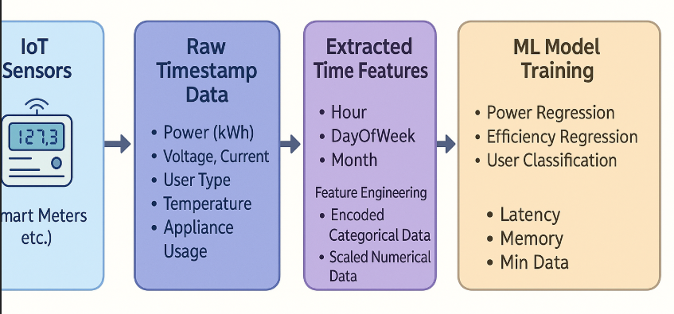
Schematic Diagram of Dataset:

Slide 33
Data Preprocessing:
This dataset represents smart grid IIoT sensor data capturing hourly electrical, environmental, and user behaviour parameters.
Includes electrical, environmental, and behavioural parameters.
It includes 14 numerical features, 4 categorical integer features, and 2 object-type features (Timestamp, Weather Condition).
Used for regression (Power/Efficiency) and classification (User Type) projects.

Slide 34
About the Data
The dataset contains 20 columns and 8,737 rows.
Some features are categorical (e.g., Weather Condition) and some are numerical (e.g., Voltage).
This report covers preprocessing for three potential prospects:
Prospect 1 (Regression): Predict Power Consumption
Prospect 2 (Classification): Classify User Type
Prospect 3 (Regression): Predict Energy Efficiency Score

Slide 35
Preprocessing Steps:
Classified original features as numerical and categorical.
Checked the distribution (balance) of the target variable for each project.
Checked for duplicate entries in the dataset (found 0).
Checked if there is missing data (NaNs) (found 0).
Analyzed the statistics for each potential target variable.
Performed Timestamp Feature Engineering (creating hour, week, month).
Encoded categorical data (e.g., Weather Condition) using One-Hot Encoding.
Applied Feature Scaling (StandardScaler) to all numerical features.
Checked the correlation of features with each project's target label, being careful to avoid data leakage.

Slide 36
Improvements:
StandardScaler was used as most features are continuous and normally distributed. It centers data around zero mean, improving model stability and convergence.
The Timestamp was converted into hour, day_of_week, and month to capture temporal consumption patterns.
Outlier detection was considered but not applied as all numerical features showed consistent statistical spread.

Slide 37
Feature Classification:
Numerical Features:
Voltage_V,
Current_A,
Power_Factor,
Grid_Frequency_Hz,
Reactive_Power_kVAR,
Active_Power_kW,
Temperature_C,
Humidity_%,
Solar_Power_Generation_kW,
Wind_Power_Generation_kW,
Previous_Day_Consumption_kWh,
Normalized_Consumption,
Energy_Efficiency_Score
Categorical Features:
Demand_Response_Event,
Weather_Condition,
Energy_Source_Type,
Peak_Load_Hour

Slide 38
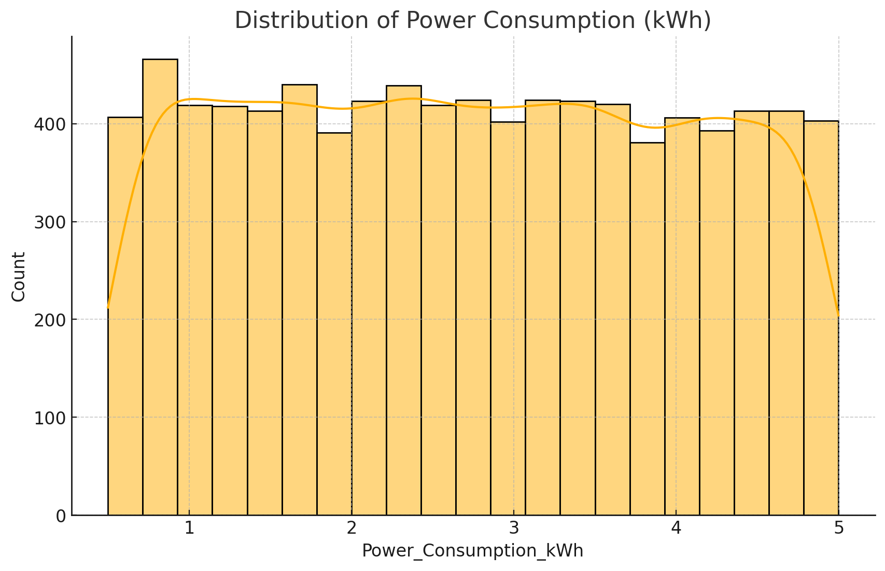
Balancing:
For regression, we see its distribution.
Mean: 2.7244
Median: 2.7153
Conclusion: Since the mean (2.72) and median (2.71) are almost equal, Power Consumption follows a near-normal distribution, indicating no skew and balanced variability — ideal for regression modelling.

Slide 39
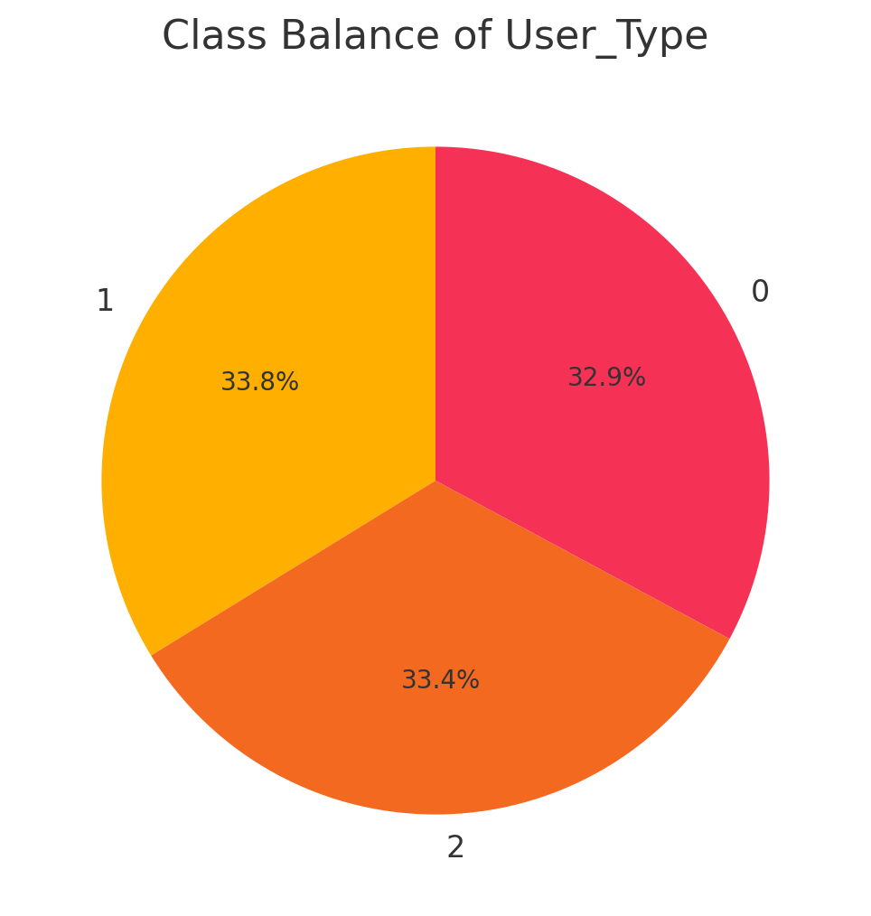
Class Balance
In classification, we check its class balance.
Class Balance for User Type: | User Type | Count | Percentage : 1.00 | 2951.00 | 33.78 | | 2.00 | 2915.00 | 33.36 | | 0.00 | 2871.00 | 32.86 |
Conclusion: The dataset is perfectly balanced for this project. All three classes have an almost equal number of samples.

Slide 40
Missing Data and Duplicate Entries
Upon preprocessing, we found out that there were no duplicate entries and no missing data.
Encoding for Categorical Data
To make use of the categorical data, we encoded it using One-Hot Encoding. This is a necessary step for all three projects.
For example, Weather Condition (with values 'Sunny', 'Rainy', etc.) was transformed into Weather_Condition_Sunny, Weather_Condition_Rainy, etc.

Slide 41
Encoding:
One-Hot Encoding avoids introducing ordinal relationships among non-ordered categories such as weather types and user types.
Integer-based categorical features like Demand Response Event and Energy Source Type were left unchanged as they represent encoded categories already.

Slide 42
Conclusion:
From the data preprocessing, we know the following:
The dataset is clean, with no missing values or duplicates.
The dataset is exceptionally well-balanced for all three proposed projects, whether for regression (symmetric distribution) or classification (equal classes).
Careful feature selection is critical.
For Project 1 (Predicting Consumption), you must drop Normalised Consumption and Energy Efficiency Score.
For Project 2 (Predicting Efficiency), you must drop Power Consumption and Normalised Consumption.
For Project 3 (Classifying User), Power Consumption and Energy Efficiency Score become two of your most important features!

Slide 43
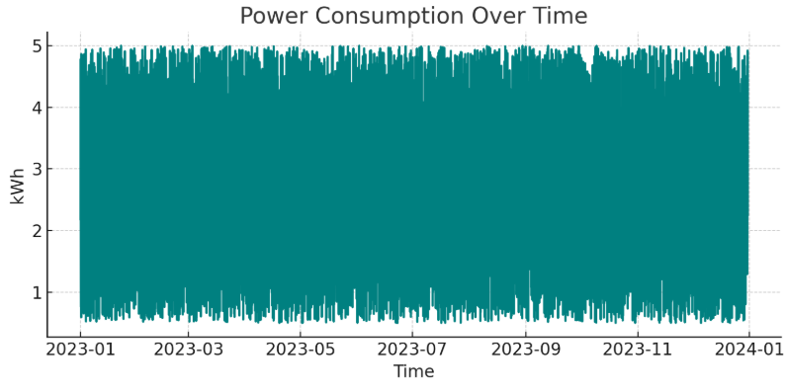
EDA of Dataset:
Active Power:
Strong positive correlation → higher active load → more consumption.
Reactive Power:
Moderate positive correlation → reactive component affects apparent power.

Slide 44
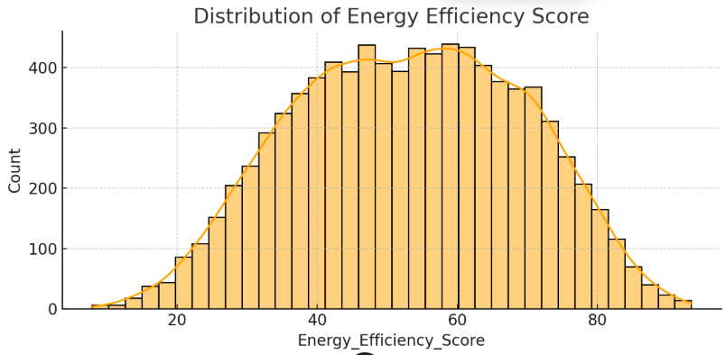
Energy Efficiency Score:
Implies that most systems perform within a consistent efficiency range.
Energy efficiency is operationally driven (through Power Factor) rather than environmentally driven. It’s independent of Power Consumption, confirming it’s a separate regression target.
higher power factor (closer to 1) → better efficiency.

Slide 45
Model Training & Evaluation:
Tasks Covered:
Power Consumption Prediction (Regression)
Energy Efficiency Score Prediction (Regression)
User Type Classification (Multi-Class Classification)
Approach Used:
Feature Engineering (Hour, DayOfWeek, Month)
One-Hot Encoding for categorical variables
Standardization for linear/SVR models
5-fold CV + Hyperparameter Tuning
Selection based on RMSE (regression) and Macro-F1 (classification)

Slide 46
Hyperparameter Tuning:
Each model underwent tuning via GridSearchCV with 5-fold CV.
Examples:
LightGBM: {num_leaves, learning_rate, max_depth}
RandomForest: {n_estimators, max_depth}
SVR: {C, epsilon}
Ridge/Lasso: {alpha}
LogisticRegression: {C}

Slide 47
Evaluation :
Regression Tasks:
RMSE (primary metric)
MAE
R² Score
Classification Task:
Macro-F1 (primary metric)
Accuracy (secondary)
These metrics reflect:
RMSE → average energy/power prediction error
Macro-F1 → balanced performance across user types

Slide 48
Models Compared:
Regression Models Evaluated:
Linear Regression
Ridge Regression
Lasso Regression
Support Vector Regression (RBF)
Random Forest Regressor
Extra Trees Regressor
Gradient Boosting Regressor
LightGBM Regressor (best)
Classification Models Evaluated:
Logistic Regression
KNN
Decision Tree
Support Vector Classifier (RBF)
Gradient Boosting Classifier
Random Forest Classifier (best)
LightGBM Classifier

Slide 49
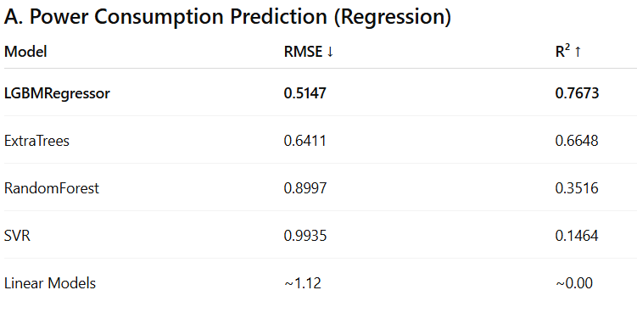
Power Consumption
Key Insights:
Strong non-linear patterns captured by boosting trees
LightGBM significantly outperforms linear models
High R² score (0.767) indicates strong predictive ability
Selected Model: LightGBM Regressor

Slide 50
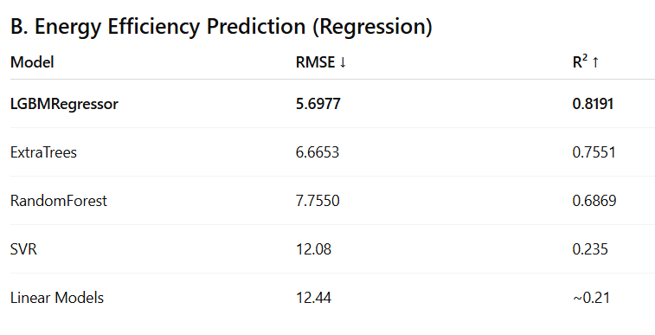
Energy Efficiency
Key Insights:
Linear models perform poorly → strong non-linear relationships
LightGBM gives highest R² (0.819) — excellent fit
Very stable across folds
Selected Model: LightGBM Regressor

Slide 51
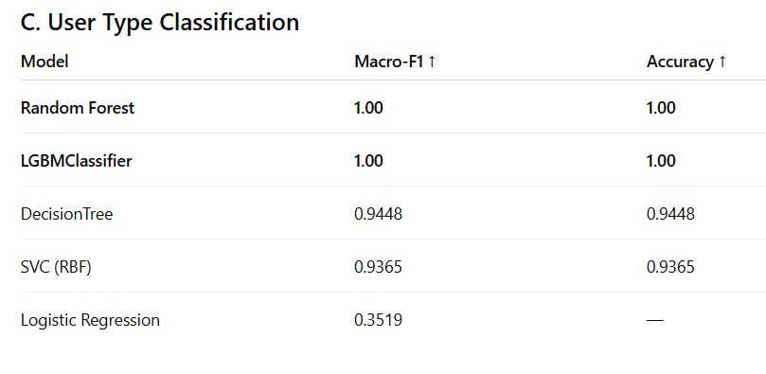
User Type:
Key Insights:
RandomForest perfectly separates user groups
Logistic Regression and KNN underperform → nonlinear decision boundaries
Selected Model: Random Forest Classifier

Slide 52
Logical Interpretation:
Unlike Random Forest and XGBoost:
LightGBM uses Histogram-based Gradient Boosting
Excellent performance even on low-end hardware
Works Extremely Well with Mixed Feature Types
LightGBM handles these efficiently.
Proven in Literature as in IEEE Smart Grid & Smart Home research consistently shows:
“LightGBM provides comparable or superior accuracy to XGBoost and Random Forest, while requiring significantly lower training time.” (IEEE Access, 2023)

Slide 53
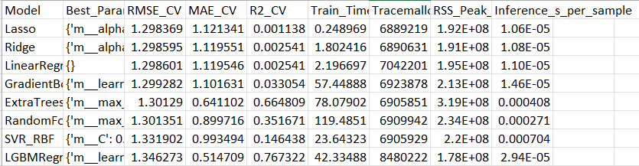
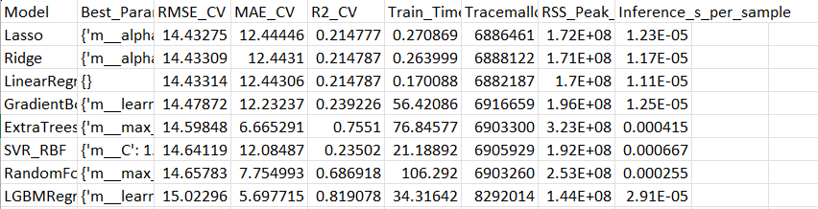
MAE,R2,Latency
Power Consumption:
Energy Efficiency:

Slide 54
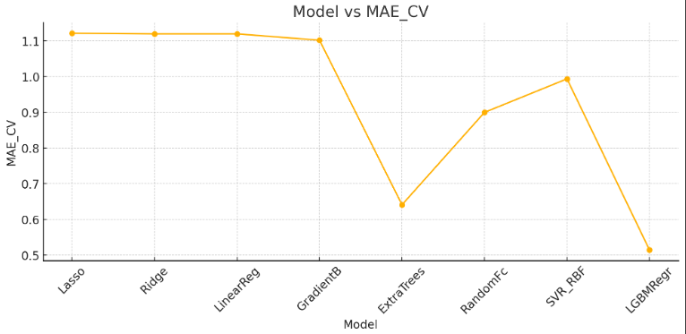
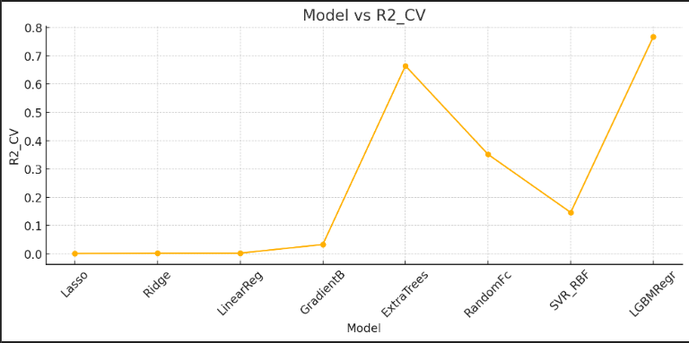
Power Consumption:
LGBM has BY FAR the highest R².
MAE(Lower the better): LGBM being the lowest
Latency of Random Forest is 0.00027s , ExtraTrees is 0.0004s but LGBM being the lowest with 2.94*10^-5 s.
Memory usage:
LGBM: 170 MB [LOWEST]
Random Forest: 223 MB
ExtraTrees: 304 MB
Training Time taken by these three were:
Random Forest: 119s
ExtraTrees: 78s
LGBM: 42s [ LOWEST]

Slide 55
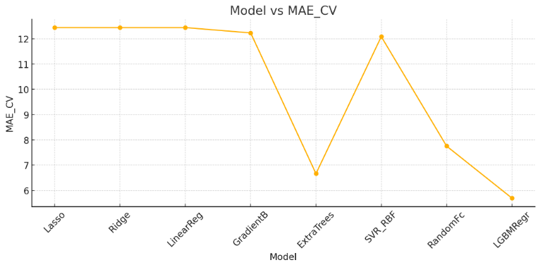
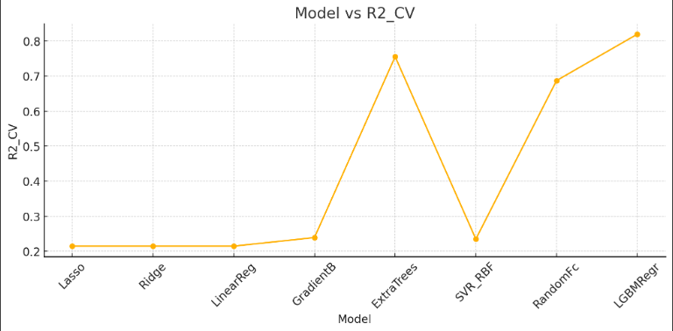
Energy Efficiency:
LGBM has BY FAR the highest R².
MAE(Lower the better): LGBM being the lowest
Latency of Random Forest is 0.00025s , ExtraTrees is 0.0004s but LGBM being the lowest with 2.91*10^-5 s.
Memory usage:
LGBM: 137 MB [LOWEST]
Random Forest: 240 MB
ExtraTrees: 298 MB
Training Time taken by these three were:
Random Forest: 106s
ExtraTrees: 76s
LGBM: 34s [ LOWEST]

Slide 56
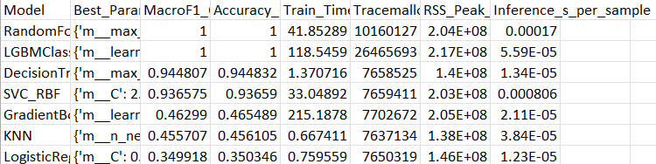
User Type:
Latency of Random Forest is 0.00017s , ExtraTrees is 0.0004s but LGBM being the lowest with 5.6*10^-5 s but RF still competitive using less memory.
Memory usage:
LGBM: 207 MB
Random Forest: 194 MB [LOWEST]
Training Time taken by these three were:
Random Forest: 41s [ LOWEST]
LGBM: 118s

Slide 57
Observations from Model Performance:
1. Regression Tasks (Power & Efficiency)
Linear models failed → clear non-linear patterns
Boosting models (LightGBM, GBM) consistently outperformed all others
ExtraTrees ranked second → strong ensemble behavior
LightGBM achieved best RMSE & R² across both tasks
2. Classification Task (User Type)
Both RandomForest and LightGBM achieved perfect classification
Decision Tree & SVC showed strong but lower performance → confirms non-linear separability
Logistic Regression & KNN weak → dataset not linearly separable
RandomForest produced cleaner ROC shape

Slide 58
Conclusion:
LightGBM is the best model for both regression tasks due to superior handling of non-linear energy consumption patterns and excellent generalisation performance.
RandomForest is the best model for multi-class user classification due to its perfect accuracy, interpretability, stable probability outputs, cleaner ROC behaviour, and robust decision boundaries.
The selected models are consistent with IEEE-reported performance patterns for Smart Grid analytics, where ensemble tree methods (boosted and bagged) outperform linear and kernel-based models.
Paper Links: https://ieeexplore.ieee.org/stamp/stamp.jsp?arnumber=10584526
https://www.researchgate.net/publication/381715670

Slide 59
References:
Munir, S. et al. Energy Consumption Prediction Based on LightGBM Empowered With Explainable AI. IEEE Access, 2024.
https://www.researchgate.net/publication/381715670
A LightGBM‑Based Power Grid Frequency Prediction Method with Dynamic Significance–Correlation Feature Weighting — Energies, 2025.
Giamarelos, N. et al. A Machine Learning Model Ensemble for Mixed Power-Load Forecasting. Energies, 2023.

Slide 60
Intrusion Detection
TANMAY KUMAR

Slide 61
Purpose
The purpose of this study is to preprocess network traffic data and develop machine learning models to detect network intrusions.
The study involves cleaning and encoding the data, selecting important features, training multiple models, and then comparing their performance to identify the most effective model for accurate and efficient intrusion detection. This helps improve network security by finding the best way to detect attacks.

Slide 62
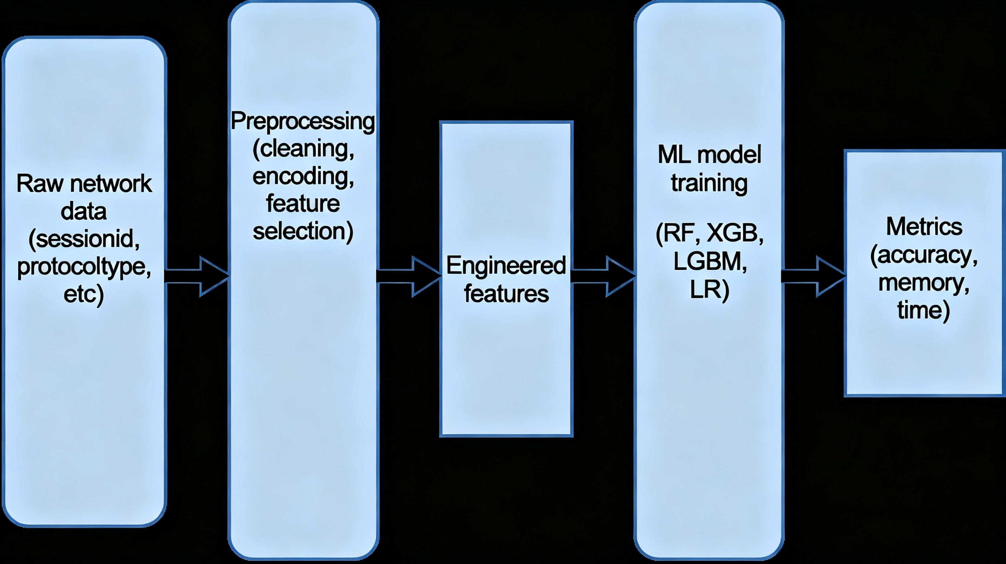
Schematic Diagram of Dataset:

Slide 63
Data Preprocessing
The dataset contains 11 columns(10 features and 1 label) and 9537 rows( data points).
Some of the features are categorical( eg session_id, protocol_type etc) and some are numerical( eg network_packet_size, login_attempts etc).
To analyse the data in different ways we make use of Python, pandas etc.

Slide 64
Preprocessing Steps
We did preprocessing in the following steps:
Classified features as numerical and categorical.
Checked if the dataset is balanced or not.
Checked for duplicate entries in the dataset.
Checked if there is missing data(NaNs).
We then found the mean, standard deviation, and data count of the label(attack_detected).
Then, for the categorical data, to use them, we encoded them using “one-hot encoding”.
We then checked the correlation of features(both categorical and numerical) with the label.

Slide 65
Feature Classification
Numerical Features:
network_packet_size
login_attempts
session_duration
ip_reputation_score
failed_logins
unusual_time_access
Categorical Features:
session_id
protocol_type
encryption_used
browser_type

Slide 66
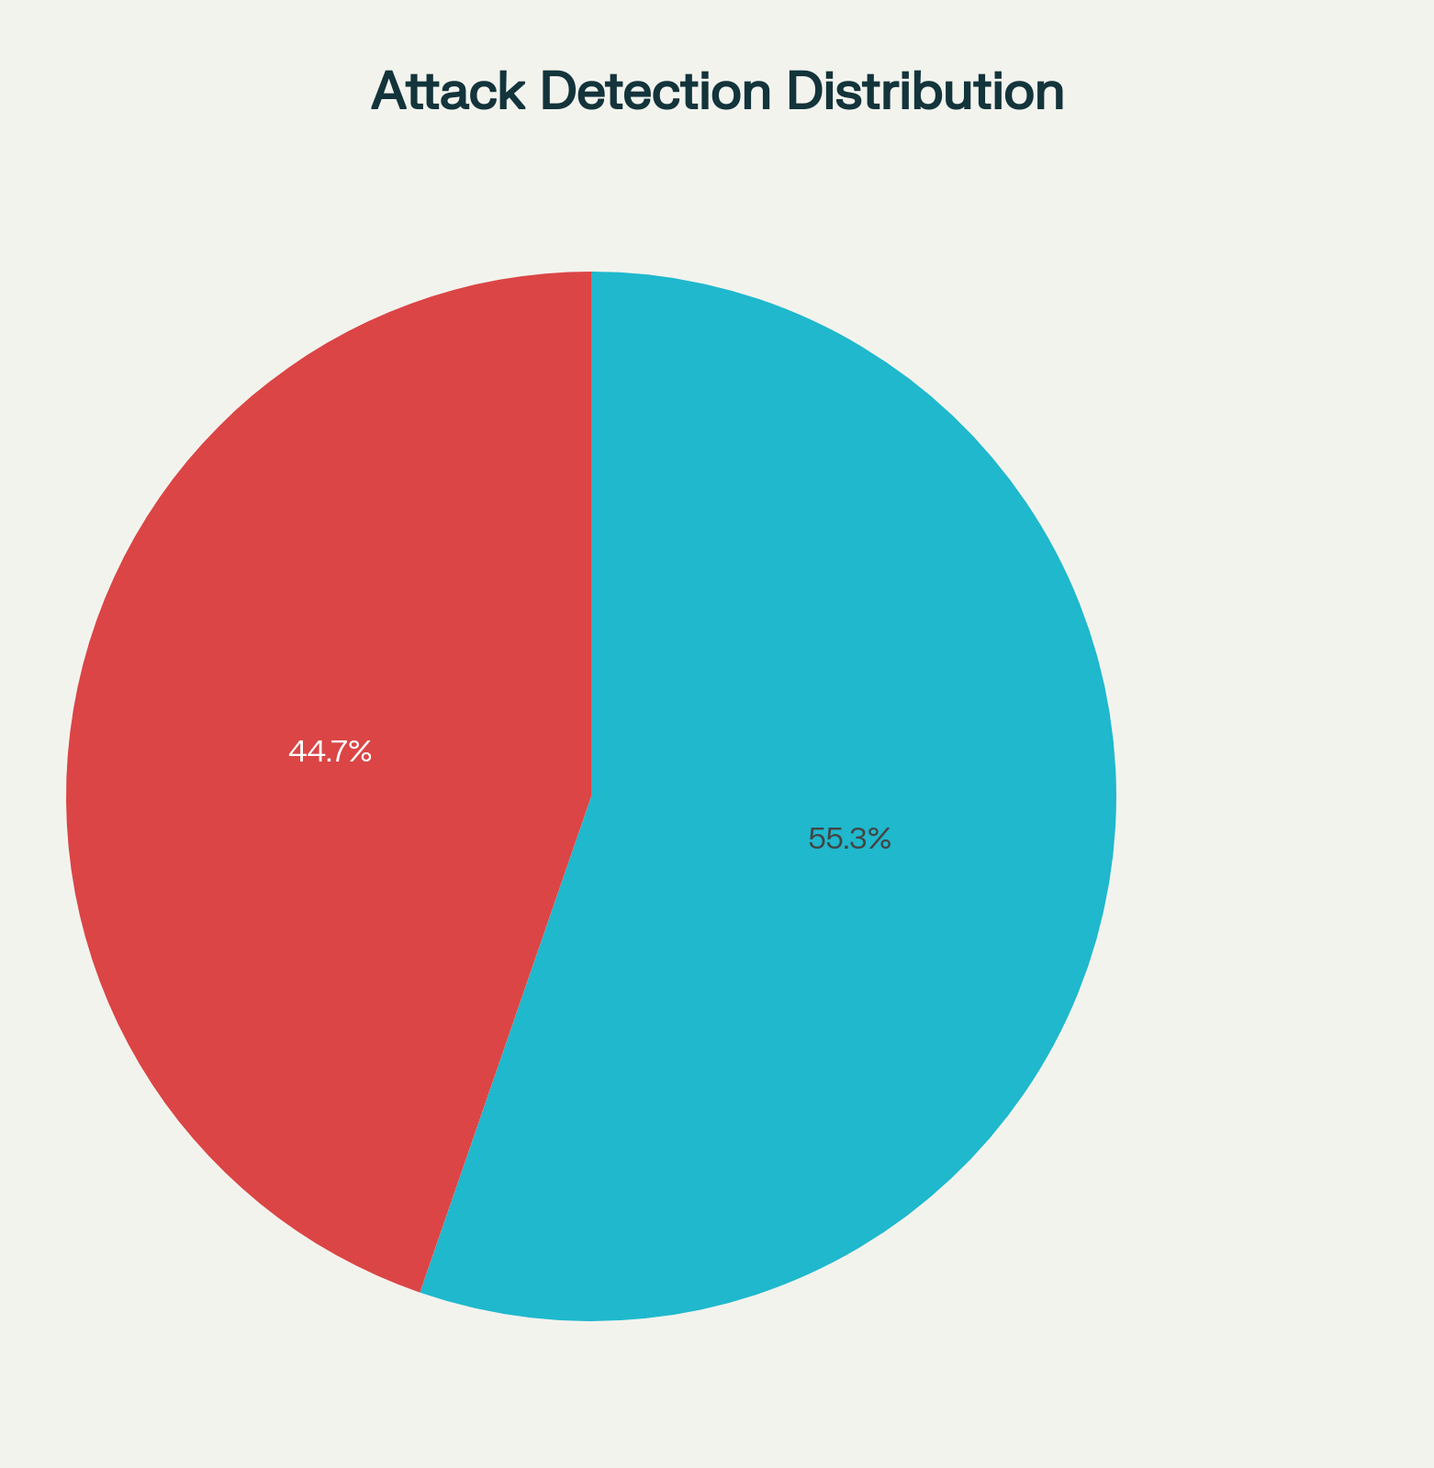
Class Balance
Class balance tells us whether our dataset is dominated by one type of prediction or is unbiased/balanced (more or less).
Upon checking for class balance, we found the data is distributed as:
Attack Detected: 4264
Attack Not Detected: 5273
Hence, the dataset is nearly balanced.

Slide 67
Missing Data and Duplicate Entries
Upon preprocessing, we found out that there were no duplicated entries and no missing data.

Slide 68
Data Analysis for the label
Upon data analysis for the label we found the following:
Data count: 9357 (as there were no missing/duplicate datapoints)
Mean: 0.44(indicating that 44% of the times attack was detected)
Standard deviation: 0.49( indicating how the data points deviate from the mean)

Slide 69
Encoding for Categorical data
To make use of the Categorical data and to find its correlation with the label, we need to encode it.
We used One-Hot Encoding for the categorical data.
Eg. The One-Hot encoding for the protocol_type categorical feature, for the first 5 rows of the dataset, is as follows:
ICMP TCP UDP
0 False True False
1 False True False
2 False True False
3 False False True
4 False True False
The protocol which is being used in a particular row is marked as “True” and the others are marked as “False”.

Slide 70
Correlation of features with the label
Upon checking the correlation of the features(numerical) with the label, we got the following:
Feature Correlation
network_packet_size -0.006798
login_attempts 0.277320
session_duration 0.041602
ip_reputation_score 0.211540
failed_logins 0.363726
unusual_time_access 0.008652

Slide 71
protocol_type
Feature Correlation
ICMP 0.412229
TCP 0.447313
UDP 0.453865
encryption_used
Feature Correlation
AES 0.436677
DES 0.453403
Upon checking the correlation of the categorical features with the label, we got the following:
browser_type
Feature Correlation
Chrome 0.437713
Firefox 0.436728
Safari 0.418557
Unknown 0.731076

Slide 72
Interpretation of Correlation
Positive Correlation: Means as this feature value increases, the likelihood of the label being "attack_detected" also increases (i.e., these features are indicative of attacks). Such features are good predictors and usually help classification models.
Negative Correlation: Means as the feature value increases, the probability of attack_detected decreases.Such features can also help the model if they indicate strong inverse relationship with the label.
Near-Zero Correlation: Means the feature shows little to no linear relationship with the target label.These features do not help the model to distinguish attack vs. normal, as their values don't change systematically with the label.

Slide 73
Conclusion for data preprocessing
From data preprocessing we got to know the following:
The dataset is more or less balanced.
Among the numerical features, failed_logins is the most important feature for analysing the label as it has the highest correlation with the label.
As for the categorical data:
In the protocol_type, it can be seen that UDP is more prone to attacks than TCP and ICMP.
Among the encryption_used, DES is more prone to attacks than AES.
Among the browser_type, Unknown(browser type) is the most prone to attacks as compared to others, which, have more or less equally prone to attacks.

Slide 74
Model Selection and Training

Slide 75
Models used for training
Random Forest: Chosen for its robustness to overfitting and ability to handle mixed numeric and categorical data with strong performance in intrusion detection.
XGBoost: Selected due to its superior predictive power leveraging gradient boosting, making it effective for complex, structured network data.
LightGBM: Picked for its fast training, scalability, and effectiveness on large feature sets typical in IoT data, with competitive accuracy.
Logistic Regression: Included as a simple, interpretable baseline model ideal for binary classification to benchmark non-complex relationships.

Slide 76
Training details:
Preprocessing & Feature Selection: Numerical features and one-hot encoded categorical features were retained only if their absolute correlation with the target label exceeded a small threshold (0.05). This ensured each feature offered meaningful predictive value while avoiding irrelevant noise.
Hyperparameter Tuning: All models underwent 5-fold cross-validated grid search over key parameters (e.g., number of estimators, tree depth, learning rate for tree methods; C, penalty, and solver for logistic regression; neighbour count and metrics for KNN).
Evaluation Metrics: Test data was held out (20%) and models were evaluated using accuracy, F1 score, and ROC-AUC for a thorough performance comparison.
ROC Curves and AUC: ROC curves were plotted for each model, and AUC was reported to visualize probability ranking and separability.

Slide 77
The minimum data points for different models are estimated based on heuristic rules reflecting the model complexity and key hyperparameters.
General estimate for minimum data points is:
Min data points= 10 x n_features
But for tree-based ensemble models, since the models build multiple trees (n_estimators) and each tree considers all features, the data requirement increases with both factors. So for Random Forest, XGB and LGBM
Min data points( for tree-based ensemble models)= 10 x n_estimators x n_features
And for Logistic Regression, since we are not building trees. Minimum data points will be equal to the general estimate, i.e.
Min data points= 10 x n_features

Slide 78
Performance Metrics
Accuracy: The percentage of total correct predictions (both positive and negative) made by the model out of all predictions
F1 Score: The harmonic mean of precision (correct positive predictions out of total predicted positives) and recall (correct positive predictions out of actual positives).
ROC-AUC (Receiver Operating Characteristic - Area Under Curve): Measures the model’s ability to distinguish between classes across all classification thresholds. It reflects the probability that a randomly chosen positive instance ranks higher than a randomly chosen negative instance.
Training time: Time taken to train a particular model on our dataset.
Peak-Memory: Maximum memory requirement by a model during training.
Est. Min Data Points: Minimum(estimated) number of data points required to train a particular model
Since the dataset used for model training is nearly balanced, accuracy and f1 score are relatively more important and ROC-AUC can be used as a supporting metric.

Slide 79
Model Performance
Model | Accuracy | F1 Score | ROC-AUC | Training Time (sec) | Peak Memory (MB) | Est. Min Data Points
Random Forest | 0.8857 | 0.8535 | 0.8716 | 8.26 | 2.60 | 18000
XGBoost | 0.8863 | 0.8543 | 0.8726 | 0.83 | 2.32 | 9000
LightGBM | 0.8863 | 0.8543 | 0.8727 | 20.65 | 4.33 | 18000
Logistic Regression | 0.7301 | 0.6827 | 0.7873 | 0.27 | 2.26 | 90

Slide 80
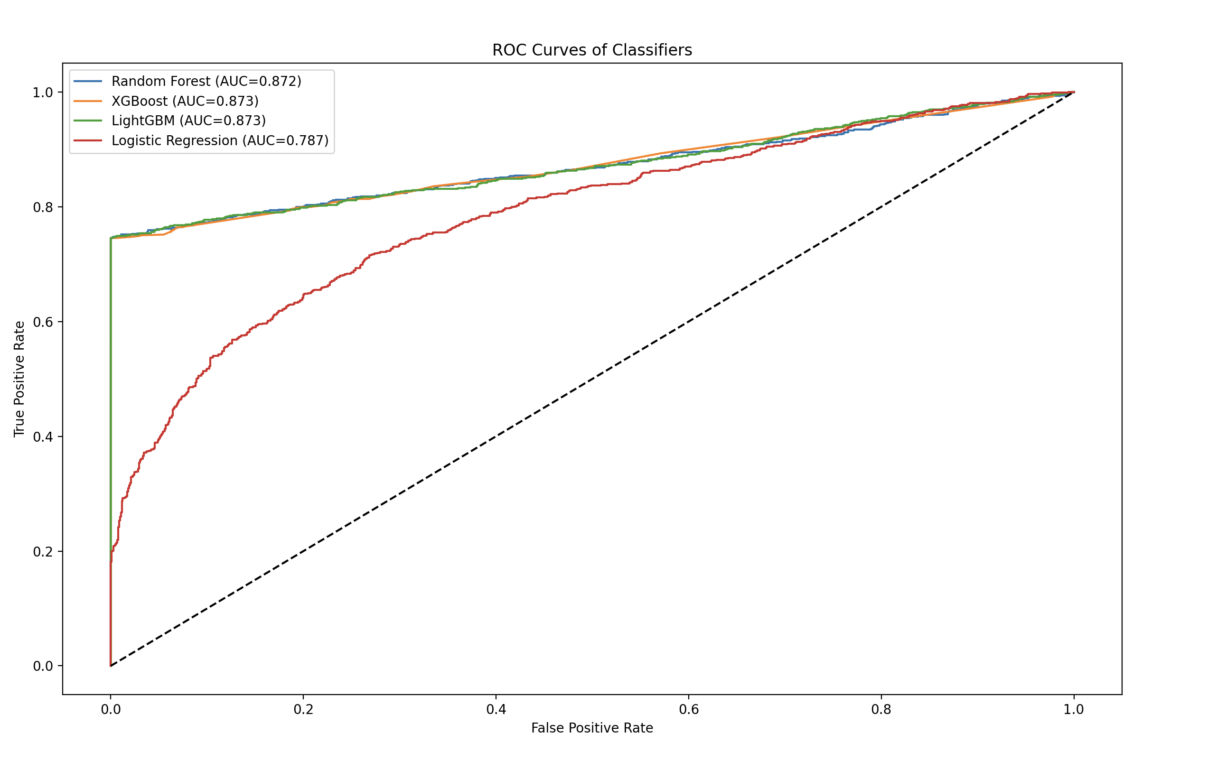
ROC-AUC Curve for different Models

Slide 81
Observations from Model Performance
All three ensemble tree models (RF, XGBoost, LightGBM) achieved nearly identical, top-tier accuracy and F1 score, reflecting the suitability of boosting and bagging algorithms for intrusion detection.
The minimum data points required for RF and LGBM are greater than the total data points present in our dataset but still their results are quite satisfactory.Also, it indicates that if we increase the number of data points then the performance of RF and LGBM may further improve.
Random Forest, LightGBM, and XGBoost have identical accuracy and F1 scores because all three are powerful tree-based ensemble models capable of capturing complex, nonlinear patterns in the dataset. Their hyperparameter tuning and effective feature selection have allowed them to converge on very similar decision boundaries and predictions.
Logistic Regression lagged considerably, suggesting strong non-linearity or feature interactions in the data.

Slide 82
Conclusion
Upon data preprocessing and model selection and training, we conclude that LGBM is the best model for intrusion detection (in terms of F1 score, accuracy and ROC-AUC).
If we consider training time, memory required and minimum data points required, then XGB outperforms LGBM (for this dataset and hyperparameters).
This is also supported by the IEEE publication “Intrusion Detection Using Machine Learning and Deep Learning Techniques”, which concludes that the performance of the LGBM-based model is better than that of the other algorithms.
Paper Link: https: https://ieeexplore.ieee.org/document/8906997

Slide 83
References
https://ieeexplore.ieee.org/document/11197417
https://ieeexplore.ieee.org/document/10271964
https://dl.acm.org/doi/10.1145/2939672.2939785
https://developers.google.com/machine-learning/crash-course/classification/roc-and-auc

